Slide 1
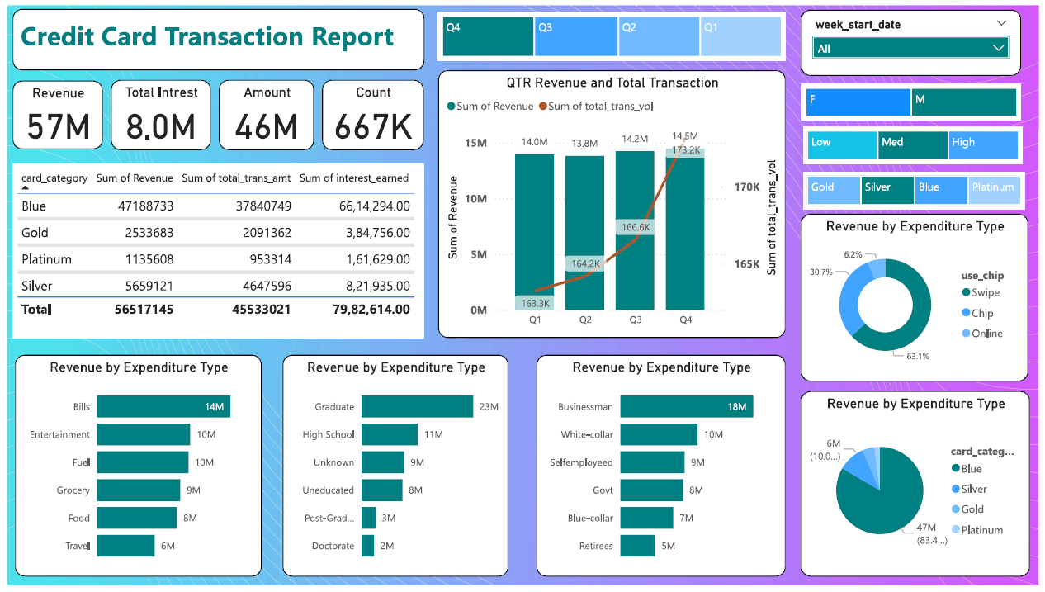

Slide 2
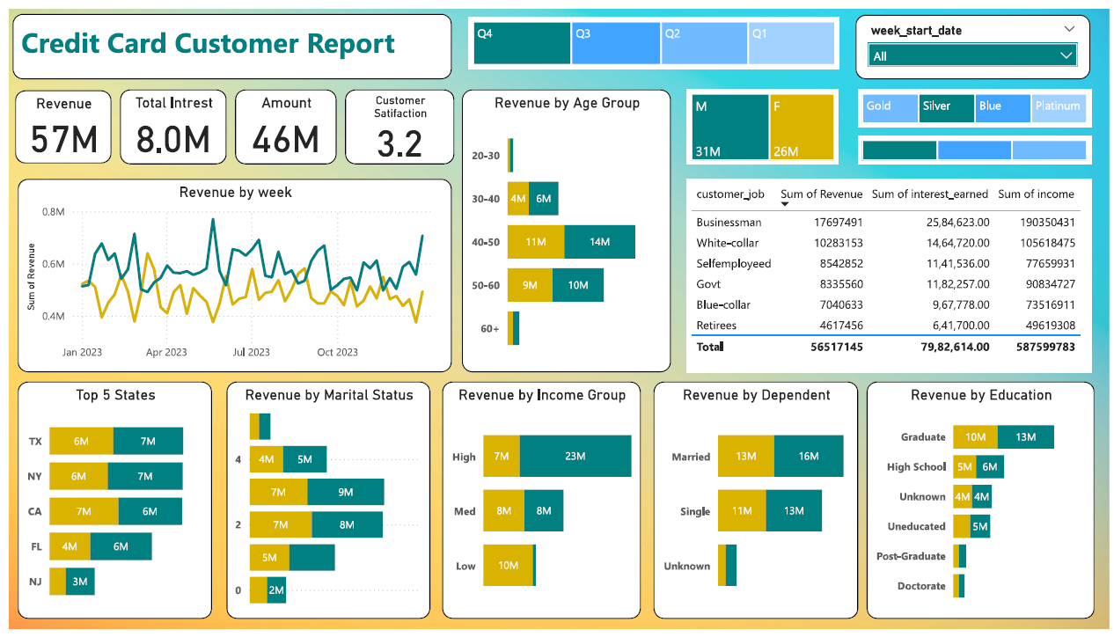

Slide 3

CREDIT CARD
WEEKLY STATUS REPORT

Slide 4

OBJECTIVE:
To develop a comprehensive credit card weekly dashboard that provides real-time insights into key performance metrics and trends, enabling stakeholders to monitor and analyze credit card operations effectively.

Slide 5


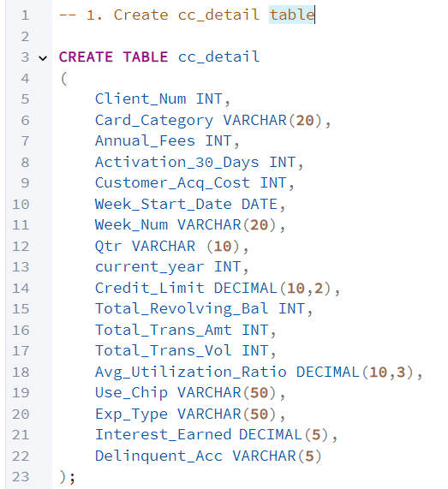
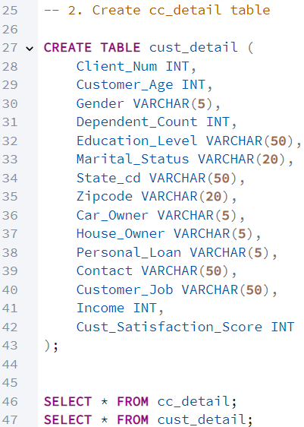
IMPORT DATA TO SQL DATABASE
Prepare csv file
Create tables in SQL
Import csv file into SQL

Slide 6
Data Preparation in Power BI
After importing the data into the SQL database, I brought it into Power BI for visualization. Before creating dashboards, I performed key data transformations to enhance clarity and usability.
STEPS:
Imported the dataset from SQL into Power BI.
Created calculated columns and measures to improve visualization.
Used DAX (Data Analysis Expressions) to write queries for transformations.

Slide 7
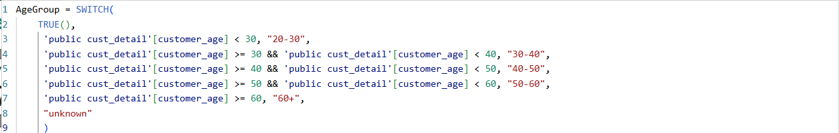
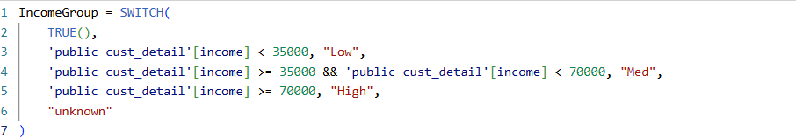
DAX Queries

Slide 8
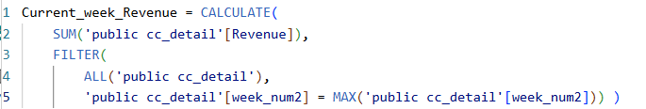
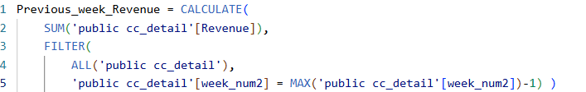
DAX Queries

Slide 9
Project Insights – Week 53 (31st Dec)
WoW Changes:
Revenue increased by 28.8 %.
Total transaction amount increased by 2.22%
Customer count increased by 1.80%.
Overview YTD:
Overall revenue is 57M
Total interest is 8M
Total transaction amount is 46M
Male customers are contributing more in revenue 31 M, female 26M
TX, NY & CA is contributing to 68%
Overall Activation rate is 57.5%
Overall Delinquent rate is 6.06%.

Slide 10
THANK YOU

